Slide 2
Build Innovative Business Applications with Database Services
DA 263 Workshop October, 2023

Slide 3
SAP BTP
Unleash digital innovation across business functions
Create personalized experiences that instantly work with SAP applications
Build faster with business context to meet change with agility
Run with confidence on a trusted, enterprise-grade platform
App Dev
Automation
Integration
Data and Analytics
AI
Build and innovate
Optimize and automate
Connect and simplify
Give data purpose
Infuse intelligence
Notes:
SAP Business Technology Platform is a unified and open platform that combines several capabilities on one business-centric public cloud platform.
1) APP DEVELOPMENT
With most companies accelerating their digital transformations, the importance of application development to business performance has grown significantly.
A recent Mckinsey study of more than 400 companies has found a clear link between accelerating software innovation and company performance.
For example, companies that can innovate faster have 60% higher total shareholder returns and 20% higher operating margins.
Today, companies must not only “master the nuances of their industry, they need to excel first and foremost at developing software.”
Yet, many companies still struggle to keep up. Can you innovate at the speed your business needs?
SAP provides a unified Low-Code/No-Code offering for professional and citizen developers to enable Low-Code Application Composition, Process Automation and Digital Experience to accelerate time to value.
The Business Builder is key to enable business growth in a company. It is solving challenges quickly leveraging business expertise to reduce burden on IT and reduce cost. Whether it is a professional developer, citizen developer/automator or business user. With our LCNC offering, we enable everybody in a company with any development skills to become a champion of change.
Therefore we comprise several capabilities like Process Automation & Workflow, Application Development and Digital Experience to support and enable the “Business Builder” to realize business outcomes.
2) AUTOMATION
SAP powers many of our customer's most mission critical processes like quote to cash and hire to retire. Within these processes are many predictiable, rote tasks. By automating routine tasks organizations can execute faster, reduce errors, and free up people to work on more meaningful projects.
Our SAP Build Process Automation solution combines workflow management to help create forms, manage decision logic, and build, adapt, and organize process flows with simple drag-and-drop functionalities. And robotic process automation to automate human tasks. These can be attended or unattended so people can support the task or have it run hands-free. This is all possible with a no-code front end business users can use themselves, or with the support of IT.
Pre-built content and connectors for SAP and non-SAP solutions helps you get started quickly.
3) INTEGRATION
Integrate applications on premise, in the cloud or in a hybrid model, while securely connecting applications, processes and people.
Integration of SAP and beyond to include 3rd parties, including API management, B2B/B2G support, data integration, event-based, IoT support and process integration
Ready built content that includes integration packs, APIs, business events, and connectors
Continuous access to best-practices via pre-packaged SAP business content
AI-powered Content Advisor to speed integration development and lower on-going support costs
4) DATA & ANALYTICS
While 70 % of the transactions touch an SAP environment, SAP owns only 3% of the available data. The rest is sitting in disconnected systems or data lakes, where it is of low value for the customer as it is not contextualized.
Coming from a siloed data landscape SAP decided to act and worked on the integration of the Intelligent Suite components on the BTP platform. Driven by process integration the result is a first version of an aligned data model across the suite components, that allows the execution of end-to-end business processes.
This aligned data model acts like a fertilizer for the gras. Highly valuable data that is connected to each other – everybody is eager for.
Besides this it provides SAP the basis to harness the value of the individual datasets as they are connected to each other.
For this SAP BTP provides a broad range of capabilities in DATA & ANALYTICS for
DATABASE (as a Service) (storage (in-memory, disc, object store – basically the data pyramid), multi-model engines, embedded ML (APL, PAL) & federation capabilities (SDA), developer tooling to build powerful applications)
DATA MANAGEMENT (pipelining, real-time transformations (view building), self-service data preparation, self-service modeling (analytical & relational)
DATA Warehouse rich set of connectivity for data integration incl real-time (RTR), data quality, metadata management, master data management (here I would stray conservative), data governance & cataloging, data access management)
ANALYTICS & PLANNING (BI, planning, predictive)
This capabilities gives you the possibility to Integrate, Store, Catalog, Prepare, Model and Share your data, in- and outside of your company.
5) AI
Intelligent technology solutions change the way we live and work by optimizing processes, maximizing resources, and igniting innovation with the right combination of intelligent technologies, services, and industry expertise. With the help of Pre-Built AI Models you can realize Self-Learning Programs and Intelligent Business Processes in order to realize your Intelligent Sustainable Enterprise.

Slide 4

App.dev. sessions
SAP BTP Application Development & Automation
Integrated solutions powered by Generative AI
LOW-CODE
PRO-CODE
SAP Build
SAP Build Code
ABAP Environment
Drag-and-drop simplicity
Optimized for Java and JavaScript apps
Optimized for ABAP apps
Generative AI-powered developer productivity
SAP Integration Suite
SAP Datasphere
Enterprise Resource Management
Customer Relationship Management
Human Capital Management
Spend Management
Business Network

Slide 5



SAP Build Code
Generative AI-powered application development, optimized for Java and JavaScript developers
Simplified developer experience to drive productivity
Optimized for SAP development
Enhanced fusion development between IT and business
Generative AI-powered app development
Prebuilt integration with SAP and non-SAP systems
Secure collaboration with SAP Build low-code solutions
Turnkey development solution including SAP best practices
Trusted security for authentication, authorization, and data protection
App composability enables developer flexibility
Choice of programming language (Java, JavaScript) and IDE (built-in or Visual Studio Code)
Extensibility for SAP S/4HANA and other systems
Interoperability with ABAP Environment

Slide 6
SAP Build Code: Everything you need to follow best practices of SAP
Generative AI
User Experience
SAP Fiori elements
SAPUI5
Mobile Development Kit
UI5 Web Components
SAP Build Lobby
SAP BTP SDK for iOS
SAP BTP SDK for Android
SAP Build Code
SAP Build Apps
Service
SAP Cloud Application Programming Model (CAP)
SAP Business Application Studio
Continuous Integration & Delivery
Transport Management
Document Management
Mobile Services
Alert Notification
SAP Build Process Automation
Audit Logging
Cloud Logging Service
Event Broker
Custom Domain
Application Autoscaler
Authorization & Trust Management
Connectivity Service
Destination Service
Feature Flag Service
SAP Build Work Zone
Runtime
SAP HANA Database
SAP BTP Cloud Foundry Runtime
SAP BTP, ABAP Environment
SAP Integration Suite
SAP LoB Applications

Slide 7
DA Workshop 263
Build Innovative Business Applications with Database Services
Our support team:
Volker Saggau
Ravichandiran, Vishnu Priya
Mishra, Abhishek
Shivendu
We are working here on SAP HANA Cloud / Platform intelligent application features

Slide 8






SAP HANA Cloud | Multi-Model Architecture Combine Relational Data with Graph, Spatial, Vector and Document Data
Multi-Model Data / SAP HANA Client Access/ Python Client Access
SAP Analytics Cloud
SAP HANA Cloud
Unified Query Layer
SQL / SQLScript
Multi-Model Processing
Relational
Spatial
Graph
Vector
ML
JSON
Data Storage
Structured
Semi-Structured
Enabling similarity search scenarios on vector embeddings with SAP HANA Cloud for Gen AI kind of applications

Slide 9




New Class of Intelligent Data Apps
Answer
LLM
Intelligent Data Apps
with SAP HANA Cloud
Question
Question Embedding
Similarity Search
Text Documents (Web, PDF …)
Text chunks
Embeddings (vectors)
SAP HANA Cloud
Best matches
Vector store

Slide 10

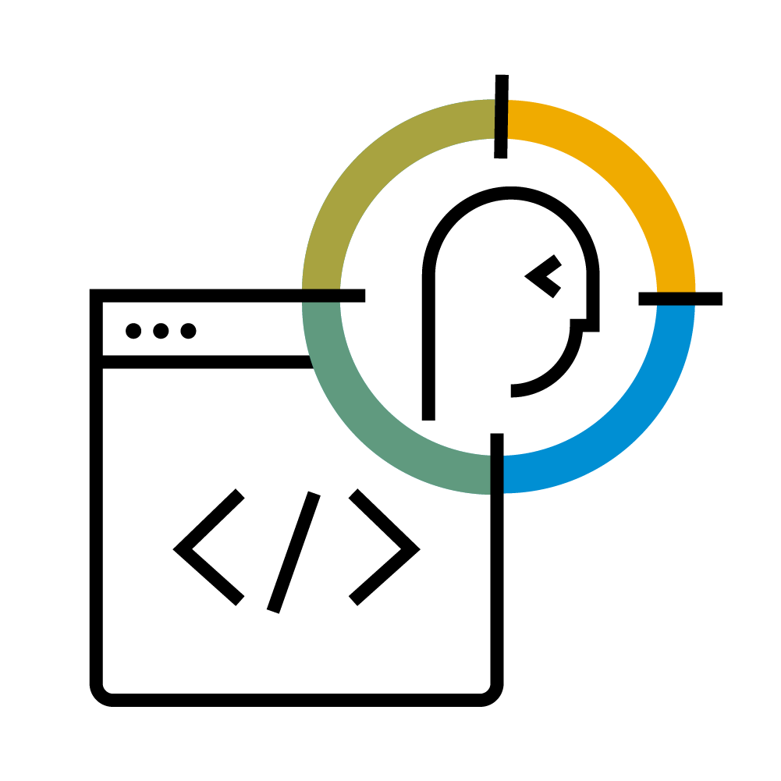


Holistic View
SAP Business Technology Platform
SAP HANA Cloud
Build your custom App
Work with structured & unstructured data
SAP CAP
CDS, OData
HANA Artifacts - Synonyms
FIORI front end
Third party API
SAP Automation Pilot
Data Extraction
Automate SQL scripts
Scheduling

Slide 11

Learn more about SAP HANA Cloud with a free Guided Experience at SAP.com!
Check the following link to start your SAP HANA Cloud guided experience
Walk through key workflows and core features in a guided manner, receive direction on what to do and where to click, and get explanations and descriptions of actions and features.
For further details check out this blog post: Building a Data Foundation for Intelligent Data Applications
If you have questions about SAP HANA Cloud, visit the SAP HANA community, where users and experts collaborate on product questions regularly.

Slide 12
Time spending:
Introduction 15 mins 15
Setup 10 mins 25
Tables 15 mins 40
Data Tiering 15 mins 55
Spatial 20 mins 75
DocumentStore 10 mins 85
Graph Data 15 mins 90
ML Data optinal 15 mins 105
Total 105 mins

Slide 13
Important access information
Business Application Studio:
https://da263-pj0569xc.authentication.ap11.hana.ondemand.com/login
DA263-NNN@education.cloud.sap (001..049)
Password for all users is: Acce$$teched23
CF: https://api.cf.ap11.hana.ondemand.com
IDP: tdct3ched1-platform

Slide 14
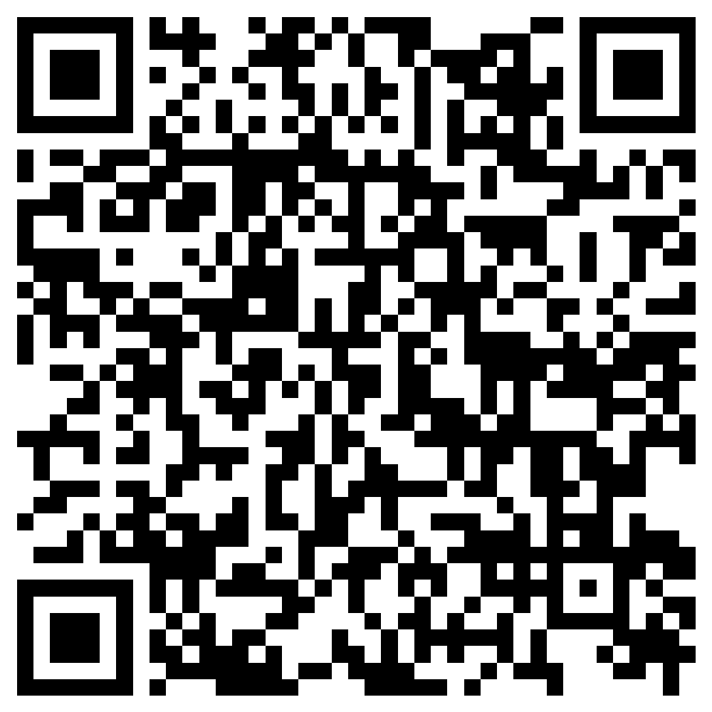
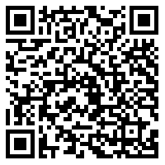
Learn more about SAP Build at TechEd 2023
Check the On-site Session Catalog: sap.com/events/teched/bangalore
Join us for these insightful sessions in Bangalore to learn about SAP Build and how it helps accelerate development and automation.
Start the SAP Build Learning Journey: learning.sap.com
Learn how to develop low-code applications, process automations, and business sites using the SAP Build toolset.
Notes:
Here are some great learning offerings to compliment your conference.
You can prepare for a certification with free SAP Learning Journeys.
Save with an exclusive SAP TechEd certification offer that came in your SAP TechEd registration email
Connect with the experts, expand your network, and share your knowledge and experiences with others in the SAP Community
And network in a moderated SAP Learning Group to get your learning questions answered
Find all the great content at learning.sap.com/teched.

Slide 15
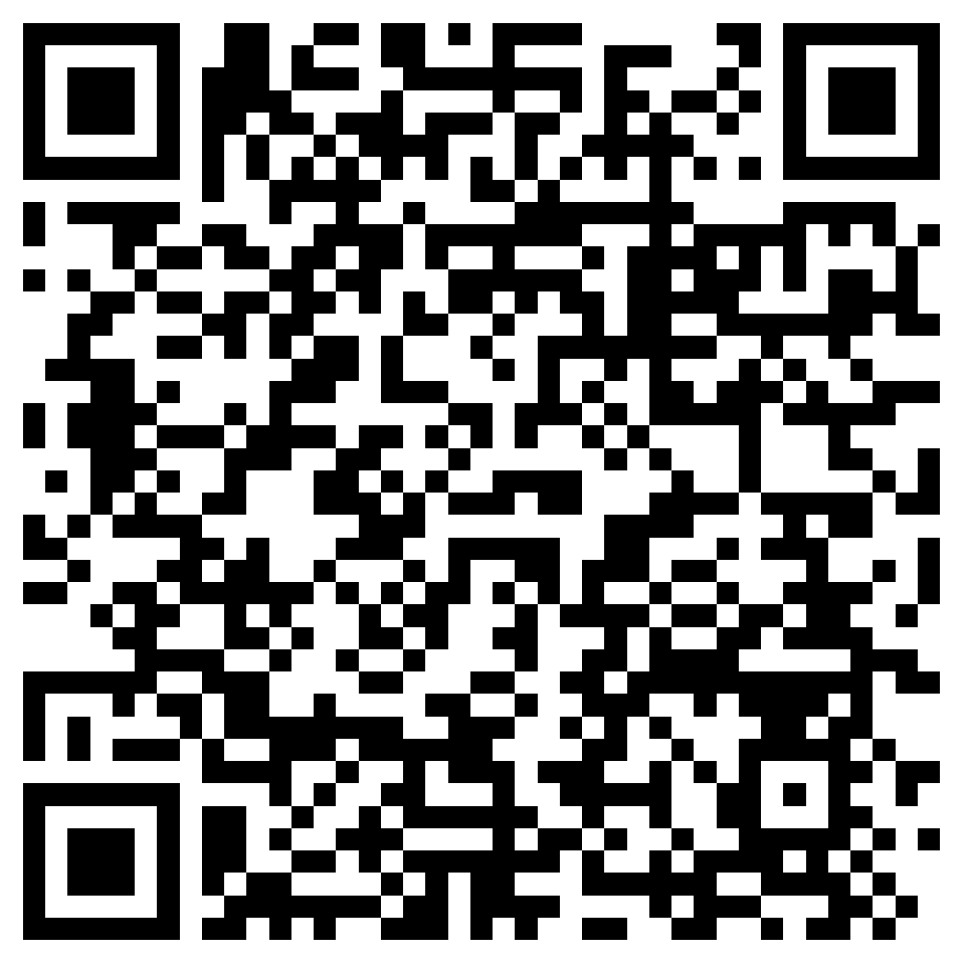

Learn more about SAP Build Work Zone at TechEd 2023
Check the On-site Session Catalog: sap.com/events/teched/bangalore
Join us for these insightful sessions in Bangalore to see how SAP Build Work Zone provides centralized access to business application information on any device.
Join the SAP Build Work Zone Community: community.sap.com
Learn how to extend SAP S/4HANA and innovate at the speed your business demands. Explore use cases, best practices, and strategies to amplify your tech expertise.
Notes:
Here are some great learning offerings to compliment your conference.
You can prepare for a certification with free SAP Learning Journeys.
Save with an exclusive SAP TechEd certification offer that came in your SAP TechEd registration email
Connect with the experts, expand your network, and share your knowledge and experiences with others in the SAP Community
And network in a moderated SAP Learning Group to get your learning questions answered
Find all the great content at learning.sap.com/teched.

Slide 16
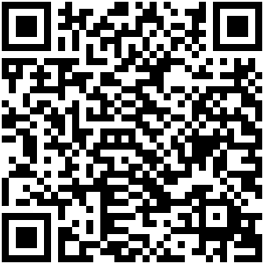

Learn more about Enterprise Automation at TechEd 2023
Check the On-site Session Catalog: sap.com/events/teched/bangalore
Join us for these insightful sessions in Bangalore that demonstrate the low-code approach to identifying and then automating as many business and IT tasks as possible.
Read more about Enterprise Automation: sap.com/enterprise-automation
To see the latest info from SAP about how to future proof your journey to become an intelligent and automated enterprise.

Slide 17
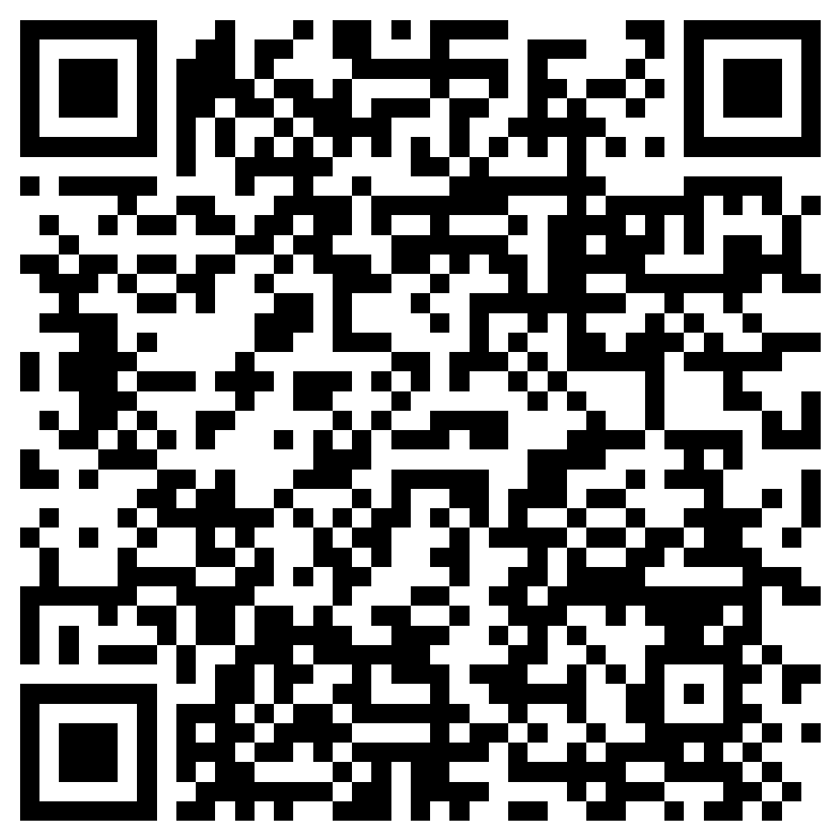

Learn more about SAP Build Apps at TechEd 2023
Check the On-site Session Catalog: sap.com/events/teched/bangalore
Join us for these insightful sessions in Bangalore to see how business users and developers are creating applications without code.
Join the SAP Build Apps Community: community.sap.com
To get the latest updates on how to build and customize enterprise applications, data models and business logic.

Slide 18

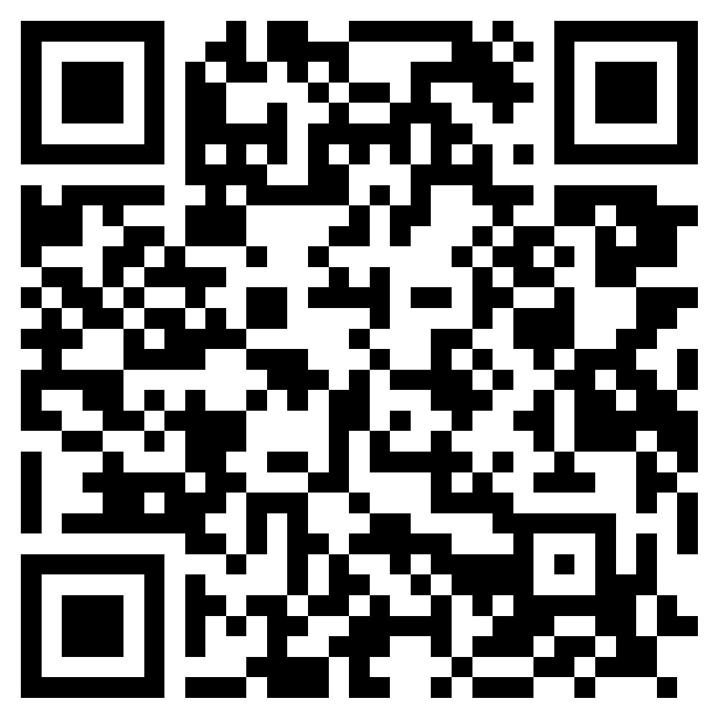
Make your career growth real
Upskill and engage on Application Development and Automation
Free learning Upskill and prepare for certification
25% discount On SAP Certification exams
Expand your network Engage with experts and share knowledge
GET REAL BENEFITS: learning.sap.com/teched
37%
Of IT certification candidates received salary increases after earning a certification*
92%
Are more confident in their abilities*
*“2023 Value of IT Certification Candidate Report,” Pearson VUE, 2023.
Notes:
Here are some great learning offerings to compliment your conference.
You can prepare for a certification with free SAP Learning Journeys.
Save with an exclusive SAP TechEd certification offer that came in your SAP TechEd registration email
Connect with the experts, expand your network, and share your knowledge and experiences with others in the SAP Community
And network in a moderated SAP Learning Group to get your learning questions answered
Find all the great content at learning.sap.com/teched.

Slide 19
Thank you
Contact information:
Volker.Saggau@sap.com
SAP HANA Product Manager

